Slide 1

MODEL-BASED INVERSION
Michael Lee
October 6th, 2022

Slide 2
Inverse Problems
What is an inverse problem?

Slide 3
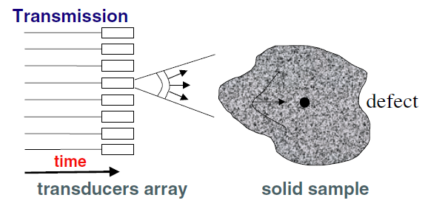
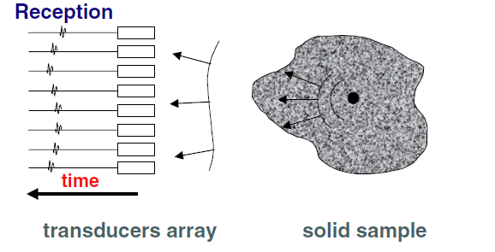
What is an Inverse Problem?
Given a set of observations, find the causes
Example – Inverse scattering
Given
Reflected signals from scatterer(s)
(observations)
Find
The location of the scatterer(s)
(causes)
Applications of Inverse Scattering
— Medical imaging (ultrasound)
— Fault detection
— Ground-penetrating radar
IMAGE SOURCE: Figure 1 from “Time reversal techniques in ultrasonic nondestructive testing of scattering media” by Prada et al

Slide 4
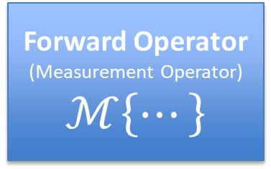
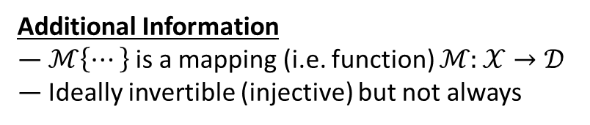
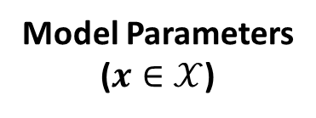
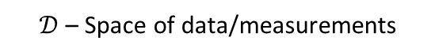
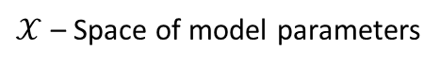
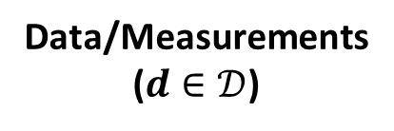
An Abstract View
Forward Operator
(Measurement Operator)
$$ℳ\left\{⋯\right\}$$
Model Parameters
($x∈𝒳$)
Data/Measurements
($d∈\text{𝒟}$)
$𝒳$ – Space of model parameters
$\text{𝒟}$ – Space of data/measurements
Examples of Model Parameters
— Scatterer locations
— Electric field amplitudes/phases
— Depth map of a surface
Examples of Data/Measurements
— Scattered signal waveforms
— Camera sensor measurements
— Phases from interferometry
Maps model parameters to measurements
Additional Information
— $ℳ\left\{⋯\right\}$ is a mapping (i.e. function) $ℳ:𝒳→\text{𝒟}$
— Ideally invertible (injective) but not always
SOURCE: [1] – Introduction to Inverse Problems, by Guillame Bal

Slide 5
The Problem
How to heights/depths on a 3D surface?

Slide 6
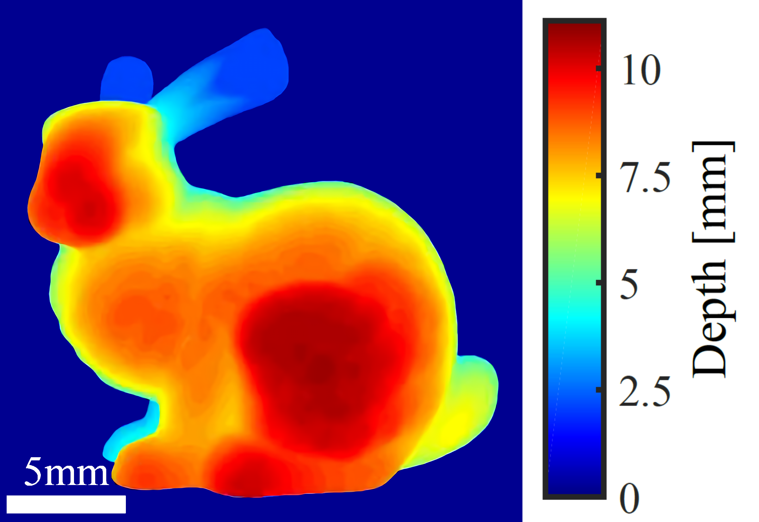
DEPTHMAPS
Depthmaps encode 3D surfaces as depths (or heights)
IMAGE SOURCE: Figure 4 from [2] – “WISHED: Wavefront imaging sensor with high resolution and depth ranging” by Wu et al

Slide 7
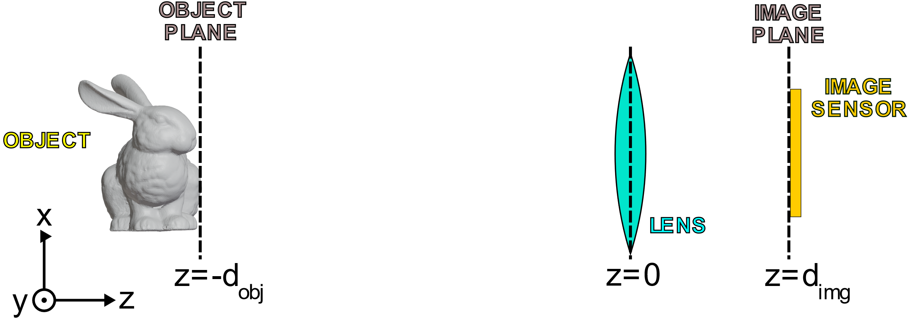
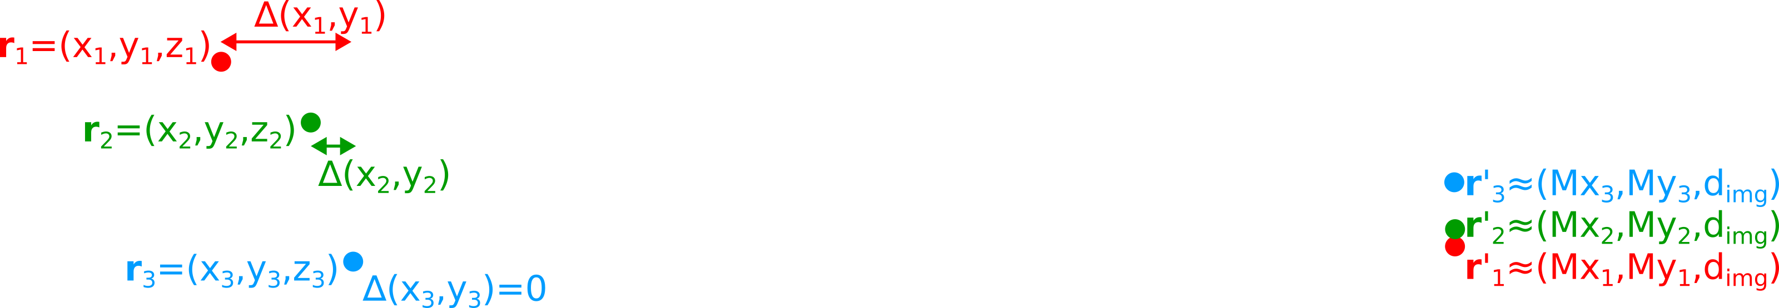
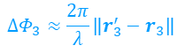
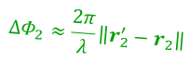
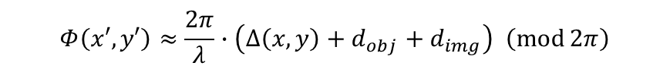
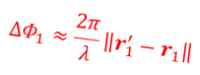
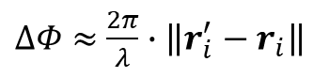
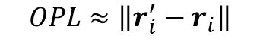
Recovering Depth from Phase
$$∆Φ_{1}≈\frac{2π}{λ}\left\|r_{1}^{′}−r_{1}\right\|$$
$$∆Φ_{2}≈\frac{2π}{λ}\left\|r_{2}^{′}−r_{2}\right\|$$
$$∆Φ_{3}≈\frac{2π}{λ}\left\|r_{3}^{′}−r_{3}\right\|$$
Lens → Same-colored lines have the same optical path length (OPL)
$$Φ\left(x′,y′\right)≈\frac{2π}{λ}∙\left(∆\left(x,y\right)+d_{obj}+d_{img}\right) \left(\operatorname{mod}{2π}\right)$$
$$OPL≈\left\|r_{i}^{′}−r_{i}\right\|$$
$∆Φ≈$ $\frac{2π}{λ}∙\left\|r_{i}^{′}−r_{i}\right\|$
Sufficiently large $d_{obj}$, $d_{img}$ → $OPL≈∆\left(x,y\right)+d_{obj}+d_{img}$
Can theoretically get depth $∆\left(x,y\right)$ from the phases at the sensor plane,
but small $λ$ complicates matters.
Notes:
Troubles with small wavelengths:
Lateral shifts cause phase shifts so phase does not perfectly correspond to depth, lens imperfections, the fact that image plane slightly shifts with differing depth, etc

Slide 8
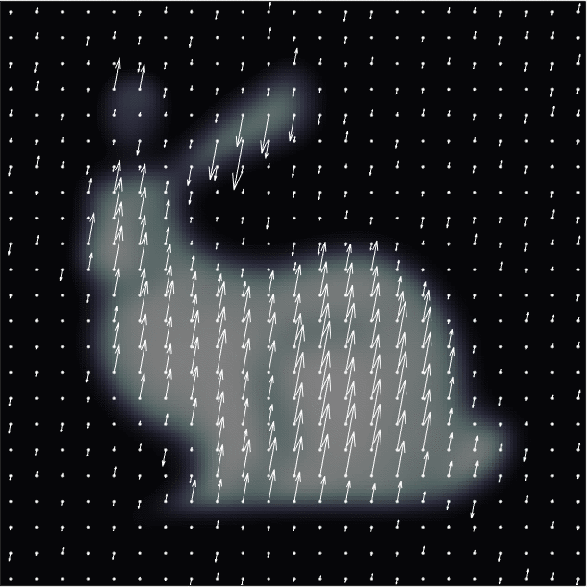
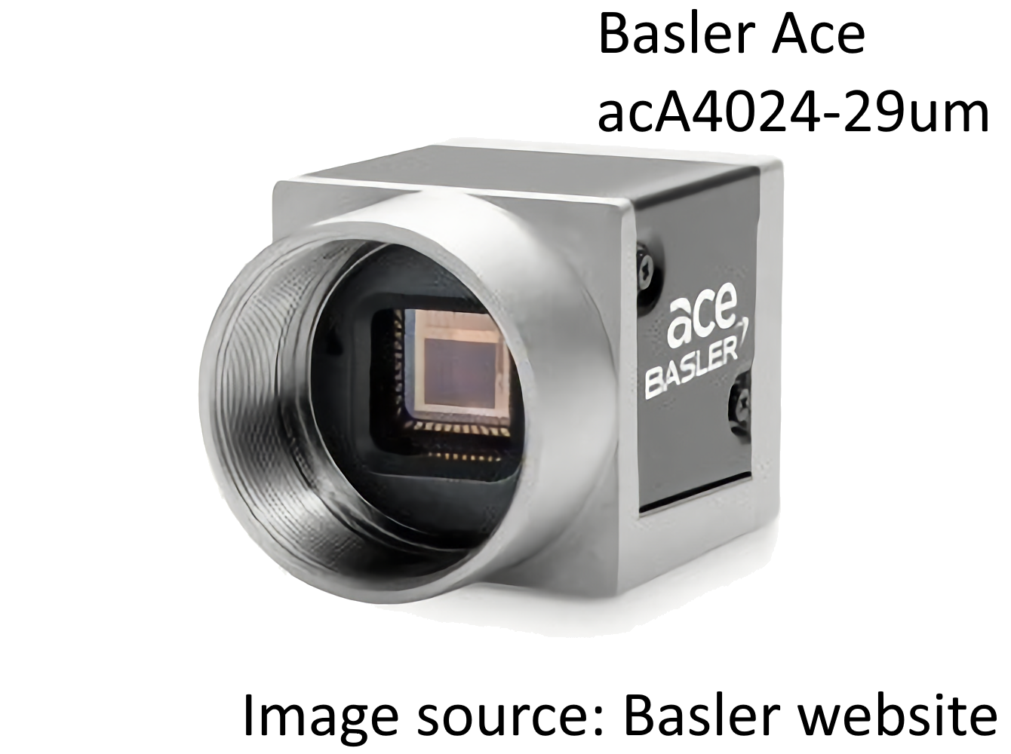
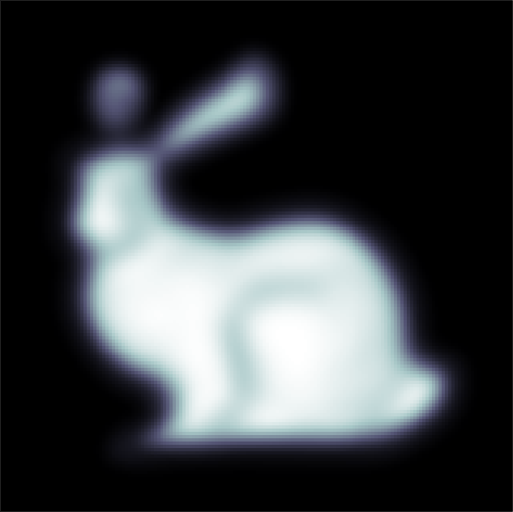
Phase Retrieval Problem
Electric field at sensor plane
Imagine (monochromatic) light shining on
a camera sensor
Standard camera sensors can only measure intensity
Electric field at each point in space has
a magnitude and a phase
Field has a magnitude and a phase at each point
Monochromatic light wavefront
Problem
How does one recover amplitude and phase?

Slide 9
WISH: Wavefront Imaging Sensor with High Resolution
Obtaining wavefront phases using computational phase retrieval
For more information on WISH, see [3].

Slide 10
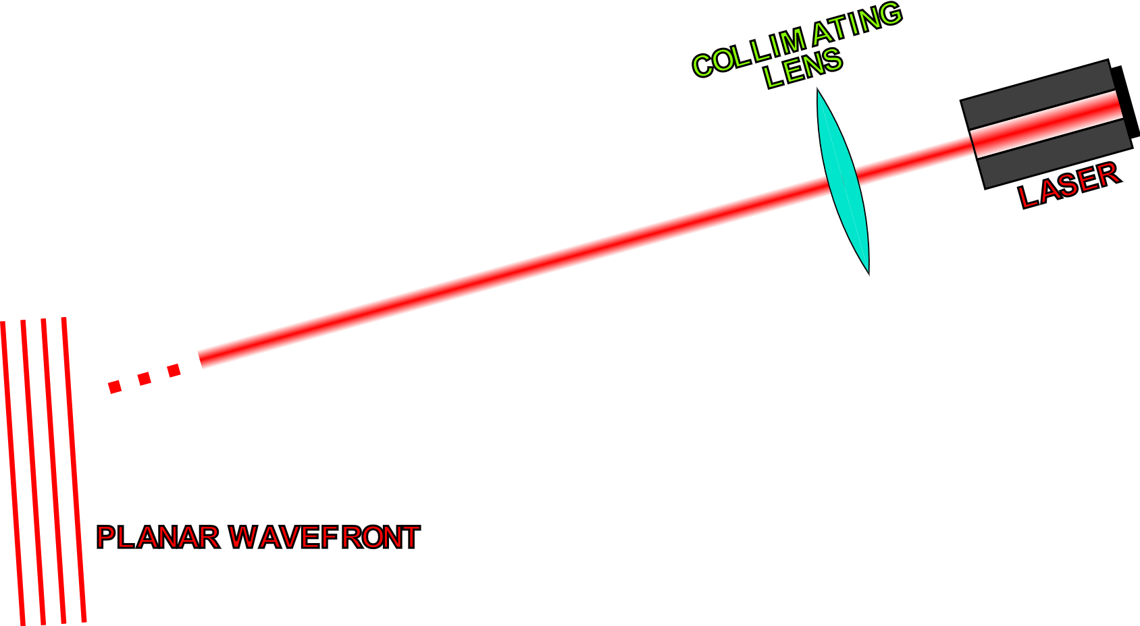
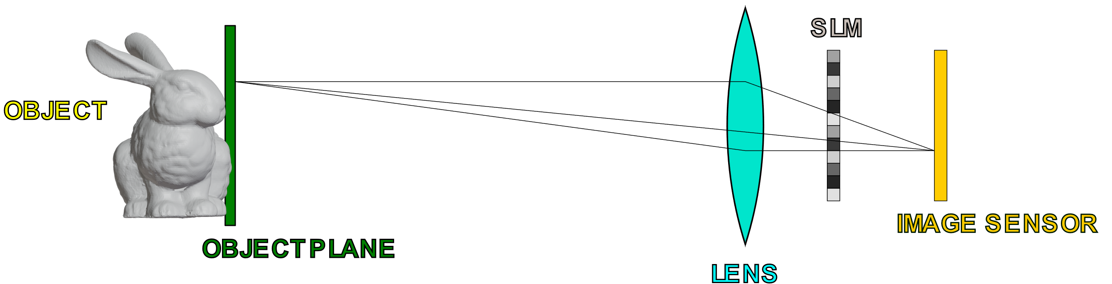
WISH(ED) Setup and General Objective
OBJECTIVE
Recover the complex field (amplitude and phase) on the image sensor plane (without the SLM)
Use the recovered phase to obtain the depthmap of the object.
NOTE: Phase-only SLM
SOURCES: [2], [3]

Slide 11
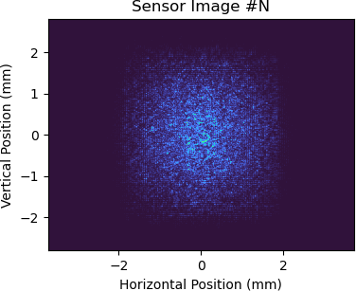
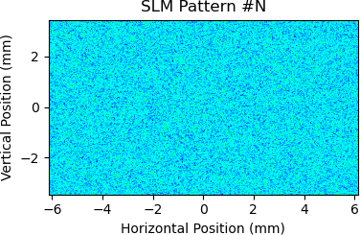
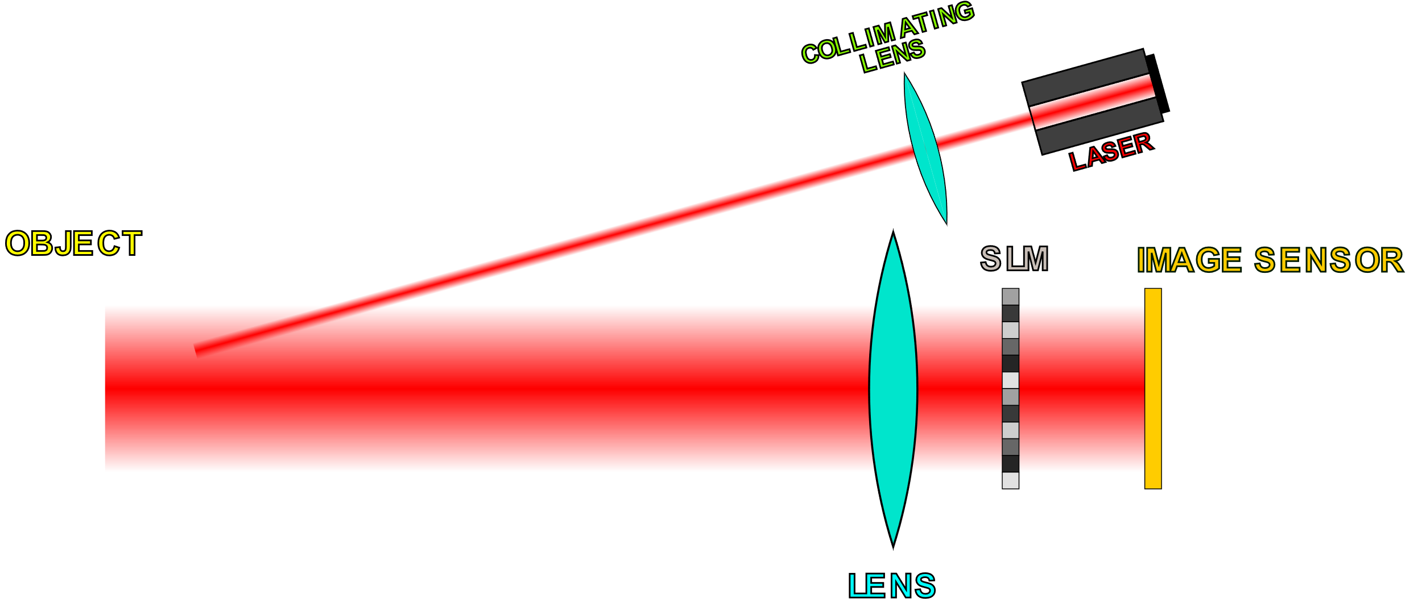
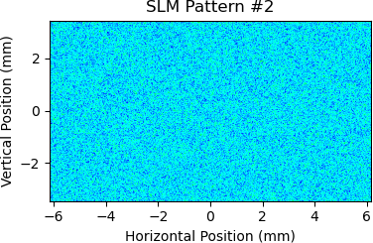
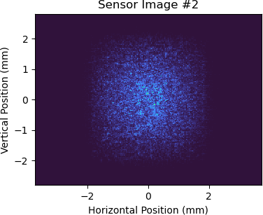
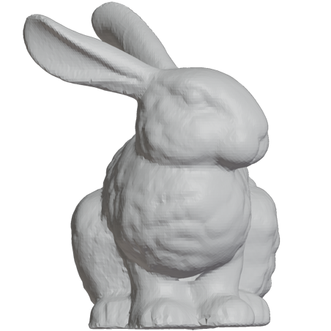
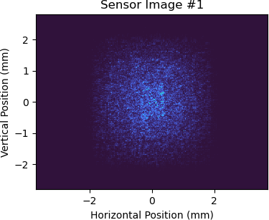
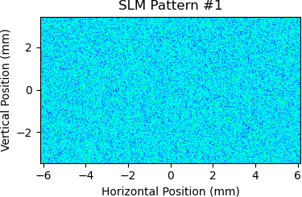
Obtaining Data
Save SLM and sensor data
Recorded Data
Acquire image from sensor
…
Display random phase pattern on SLM
SOURCE: [2]
Can use this data in conjunction with a model for SLM-to-sensor propagation to recover the complex field at the image sensor

Slide 12
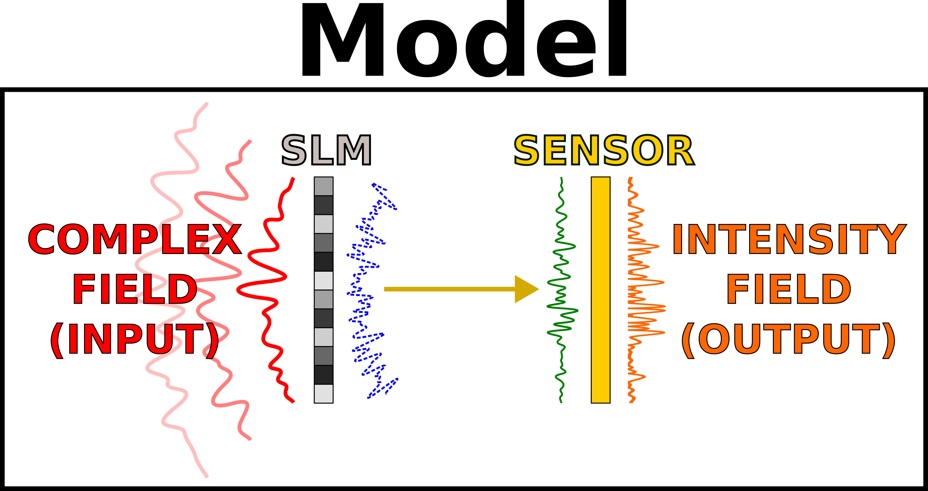
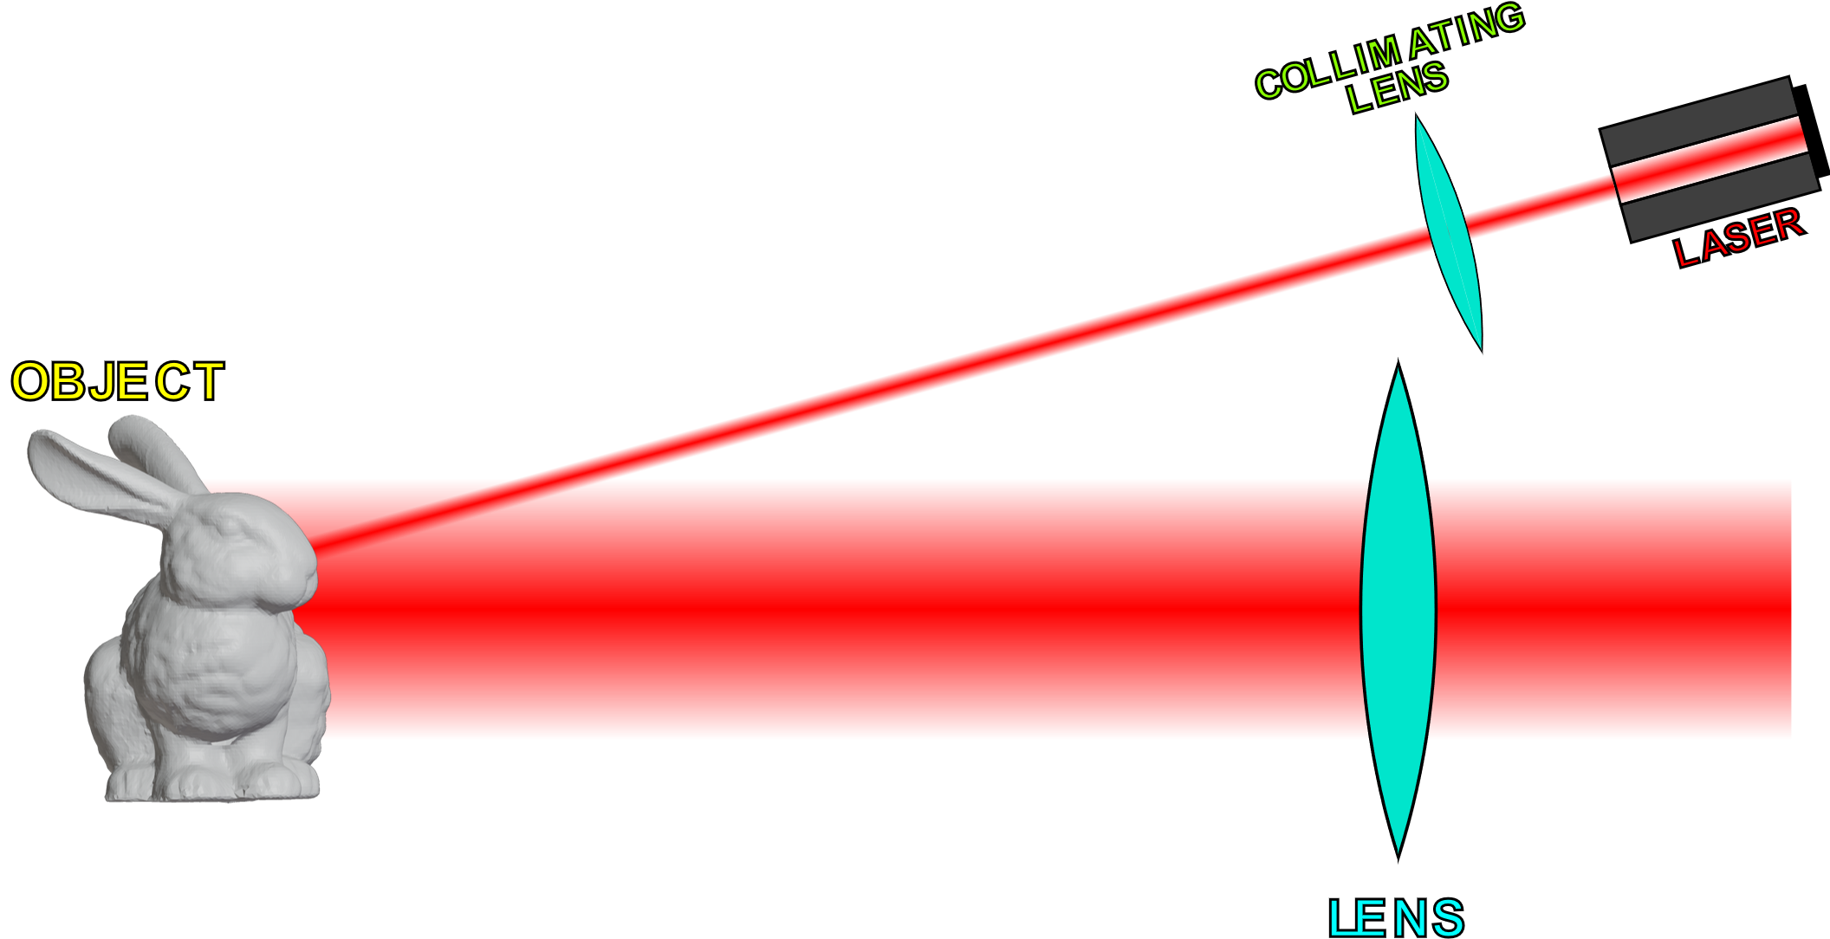
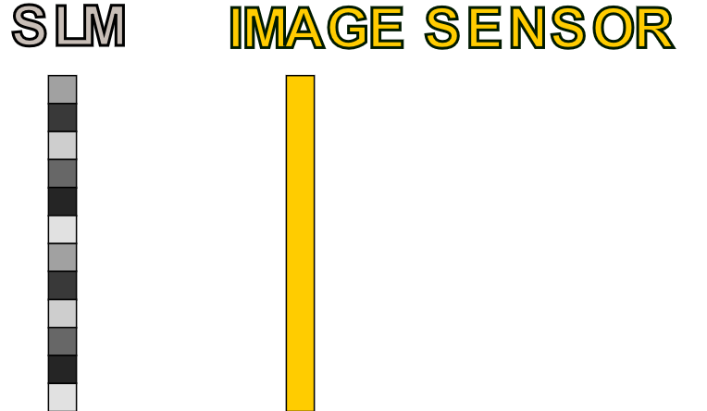
Recovering Complex Fields
Objective
Recover field (phase + amplitude) at
the image sensor
Phase Retrieval
Algorithm
Sensor Plane
Complex Fields
Can do phase retrieval
to accomplish this
]
…
SLM Patterns
and
Sensor Data
This data is known/measured
Can focus on SLM and sensor
while disregarding the rest
SOURCE: [2]

Slide 13
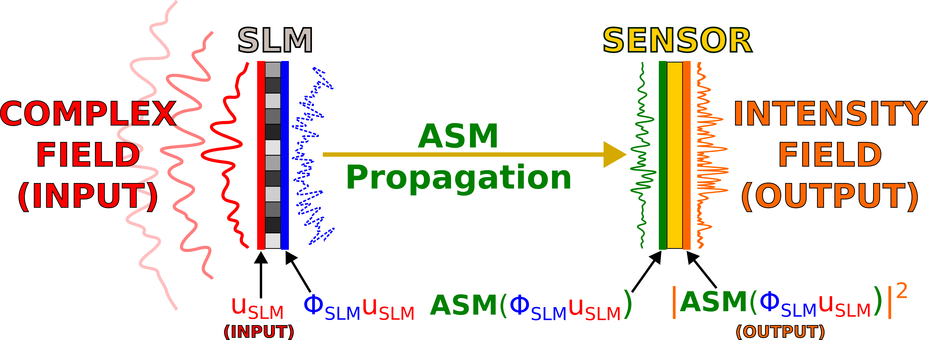
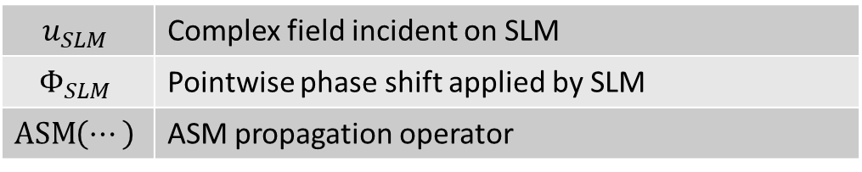
Forward Model
$$u_{SLM}$$ | Complex field incident on SLM
$$Φ_{SLM}$$ | Pointwise phase shift applied by SLM
$$\operatorname{ASM}\left(⋯\right)$$ | ASM propagation operator
NOTE: There are other ways of modeling propagation besides ASM (angular spectrum method).

Slide 14
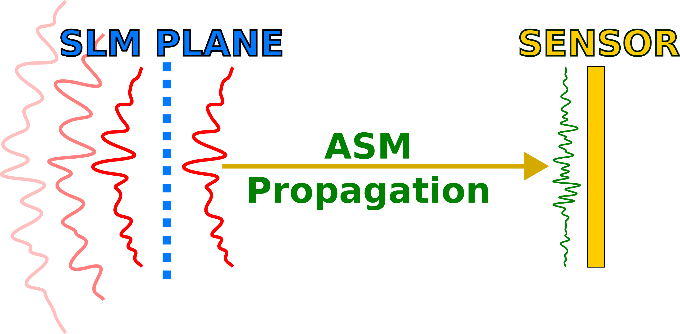
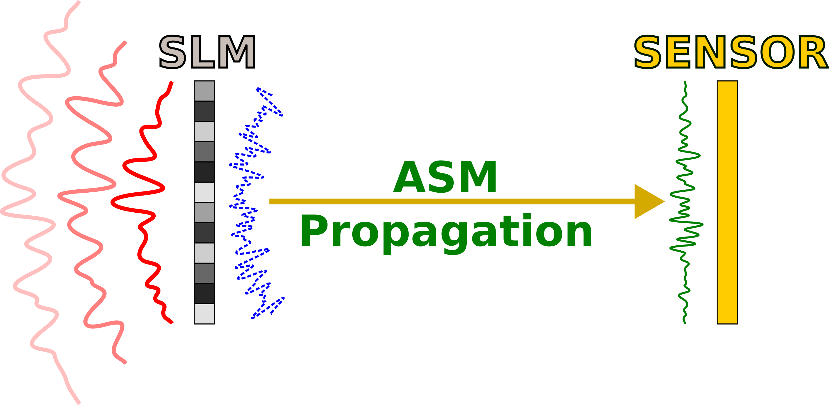
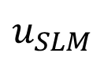
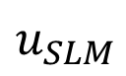
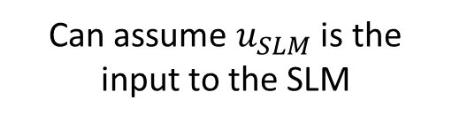
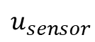
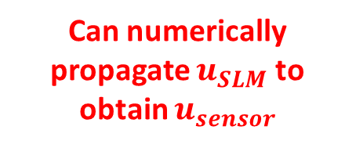
Recovering Sensor Plane Field
SUMMARY
To recover sensor fields:
1. Recover SLM input field
2. Numerically propagate the SLM input field to get the sensor field
Can assume $u_{SLM}$ is the input to the SLM
Can numerically propagate $u_{SLM}$ to obtain $u_{sensor}$
$$u_{SLM}$$
$$u_{sensor}$$
$$u_{SLM}$$
Hypothetical field w/o SLM
SOURCE: [2]

Slide 15
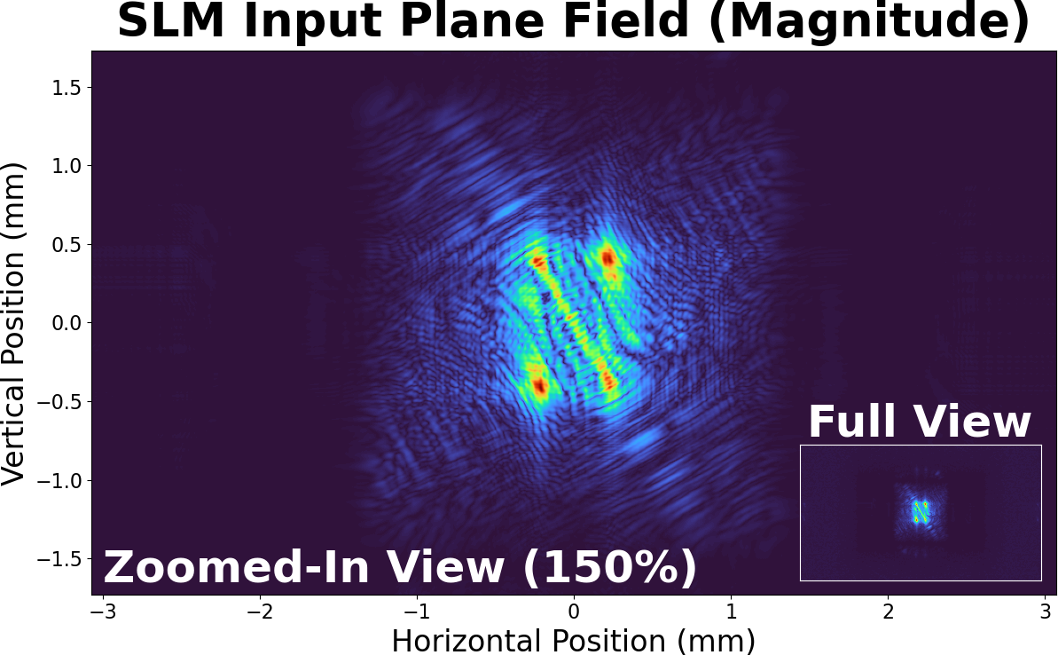
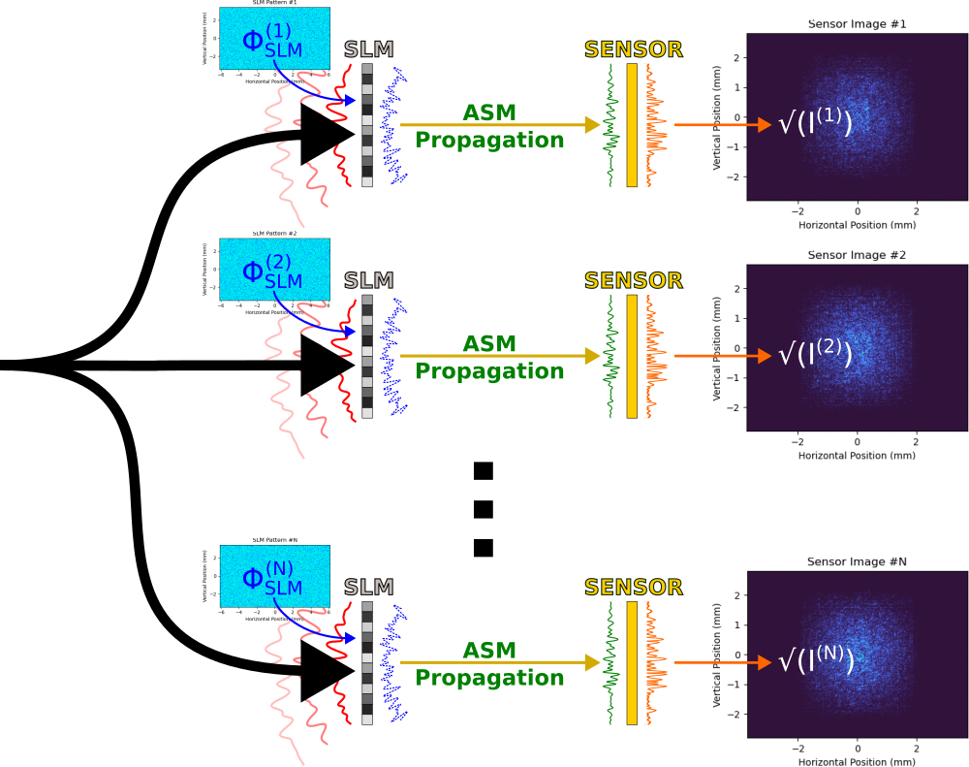
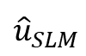
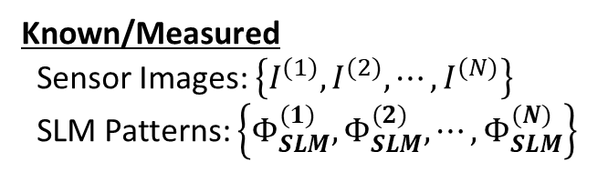

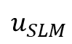
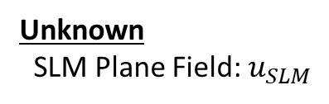
Estimating SLM Input with Optimization
?
Unknown
SLM Plane Field: $u_{SLM}$
$$u_{SLM}$$
Want to find a field ${\hat{u}}_{SLM}$ that gives approximately the same sensor images
$${\hat{u}}_{SLM}$$
Can use optimization accomplish this
Known/Measured
Sensor Images: $\left\{I^{(1)},I^{(2)},⋯,I^{(N)}\right\}$
SLM Patterns: $\left\{Φ_{SLM}^{(1)},Φ_{SLM}^{(2)},⋯,Φ_{SLM}^{(N)}\right\}$
SOURCE: [2]

Slide 16
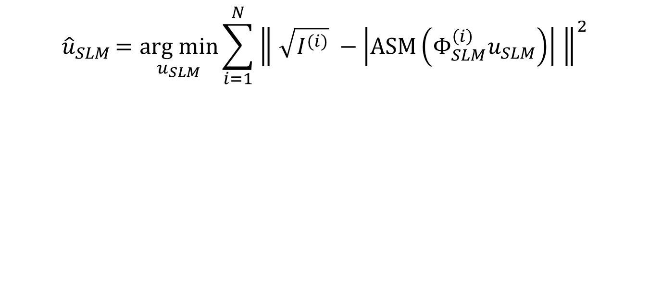
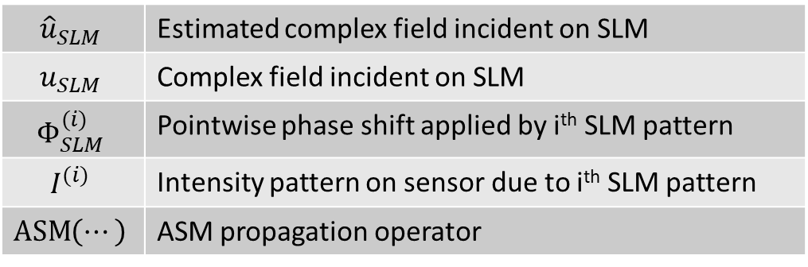
Optimization Objective Function
$${\hat{u}}_{SLM}=\underset{u_{SLM}}{arg min}{\sum_{i=1}^{N}{{\left\| \sqrt{I^{(i)}} −\left|\operatorname{ASM}\left(Φ_{SLM}^{\left(i\right)}u_{SLM}\right)\right| \right\|}^{2}}}$$
CORE IDEA |
Minimize error between measured intensity patterns and intensity patterns output by model
$${\hat{u}}_{SLM}$$ | Estimated complex field incident on SLM
$$u_{SLM}$$ | Complex field incident on SLM
$$Φ_{SLM}^{(i)}$$ | Pointwise phase shift applied by i^{th} SLM pattern
$$I^{(i)}$$ | Intensity pattern on sensor due to i^{th} SLM pattern
$$\operatorname{ASM}\left(⋯\right)$$ | ASM propagation operator
SOURCE: [2]
NOTE: Other propagation operators besides ASM can also be used.
Notes:
Methods for phase recovery:
Gerchberg-Saxton
Minimizing objective function
System model + PyTorch autograd

Slide 17


Phase Recovery Results (Single Wavelength)
Small $λ$ → Wrapped phases
Wrapped phases are bad for depth recovery
IMAGE SOURCE: Figure 5 from [2] – “WISHED: Wavefront imaging sensor with high resolution and depth ranging” by Wu et al

Slide 18
WISHED: Wavefront Imaging Sensor with High Resolution AND DEPTH RANGING
Improving unambiguous depth range using wavelength diversity
For more information on WISHED, see [2].

Slide 19

Issues with Small Wavelengths
Depth ambiguity
Phase wrapped to $[0, 2π)$ or $(−π, π]$, corresponds to a range of $λ$
Object roughness → Path length variations $≫λ$
Lateral shifts can affect phase (not just depth shifts)
??? → Image plane location depends on $z$, variation might be $≫λ$

Slide 20

Synthetic Wavelengths
Big picture
Can correlate (“multiply”) two complex fields of nearby wavelengths together to get a larger, synthetic wavelength.
Height/depth
Synthetic wavelength
(𝛬)
SOURCE: [2]

Slide 21

Advantages of Synthetic Wavelengths
Better unambiguous range
$Λ≫λ_{1},λ_{2}$ → wrapped phase for $Λ$ spans larger length
Can combine with an even larger synthetic wavelength to help further unwrap
Less susceptible to path length variations
Less affected by surface roughness
SOURCE: [2]

Slide 22


IMAGE SOURCES: Figures 5 and 12 from [2] – “WISHED: Wavefront imaging sensor with high resolution and depth ranging” by Wu et al

Slide 23
Demo with Synthetic Data*
Done with Python/PyTorch with the Holotorch library [4]
*Of questionable quality/validity.

Slide 24



Visualizing the Test Object
NOTE: This is synthetic data, shown for illustrative purposes.

Slide 25





Recovered Sensor Plane Fields
$$u_{sensor}^{\left(λ_{1}\right)}$$
$$u_{synthetic}^{\left(Λ\right)}$$
$$u_{synthetic}^{\left(Λ\right)}=u_{sensor}^{\left(λ_{1}\right)}∙{\left(u_{sensor}^{\left(λ_{2}\right)}\right)}^{∗}$$
Many discontinuities
Infeasible to unwrap phase
No difficult discontinuities
Phase related to depth
$$u_{sensor}^{\left(λ_{2}\right)}$$
NOTE: This is synthetic data, shown for illustrative purposes.

Slide 26

Recovered Depthmaps from Synthetic Data
Median filter
(To remove spikes)
Gaussian filter
(See 2020 WISHED paper)
NOTE: This is synthetic data, shown for illustrative purposes.

Slide 27

Recovered Depthmaps (3D Visualization)
NOTE: This is synthetic data, shown for illustrative purposes.

Slide 28
References
[1] G. Bal, Introduction to Inverse Problems. 2019.
https://www.stat.uchicago.edu/~guillaumebal/PAPERS/IntroductionInverseProblems.pdf.
[2] Y. Wu, F. Li, F. Willomitzer, A. Veeraraghavan, and O. Cossairt, “WISHED: Wavefront imaging
sensor with high resolution and depth ranging,” 2020 IEEE International Conference on
Computational Photography (ICCP), 2020.
[3] Y. Wu, M. K. Sharma, and A. Veeraraghavan, “WISH: Wavefront imaging sensor with high
resolution,” Light: Science & Applications, vol. 8, no. 1, 2019.
[4] Facebookresearch, “Facebookresearch/holotorch: Holotorch is an optimization framework for
differentiable wave-propagation written in PyTorch,” GitHub. [Online]. Available: https://github.com/facebookresearch/holotorch. [Accessed: 21-Nov-2022].

